Slide 1

Delta Women’s Clothing E-Commerce Data Analysis

Slide 2


Customers!
Customers are sources of revenue. The success of the business is directly proportional to the ability to acquire, retain customers. The Delta’s ecommerce website realizes the importance of customer analytics and gave us the project. Our task is to give the insights of the customer behavior using data science.

Slide 3

Delta E-commerce Website
Potential customers(women) browse the website for clothes of their choice.
The website Monitors customer activity through sessions.
Customers are tagged using cookies on their browser.
Each customer can give the rating for every product they purchase from the website
The online store wants to analyze review commands and complaints to measure customer satisfaction levels. The data set we have is extracted from the customer E-commerce reviews.

Slide 4

Customer Analytics
1)Who are the potential customers demanding their products?
2) What do they want?
3) Why this Particular product?
Notes:
Predictive customer analytics is an cuntinous imporovment model

Slide 5
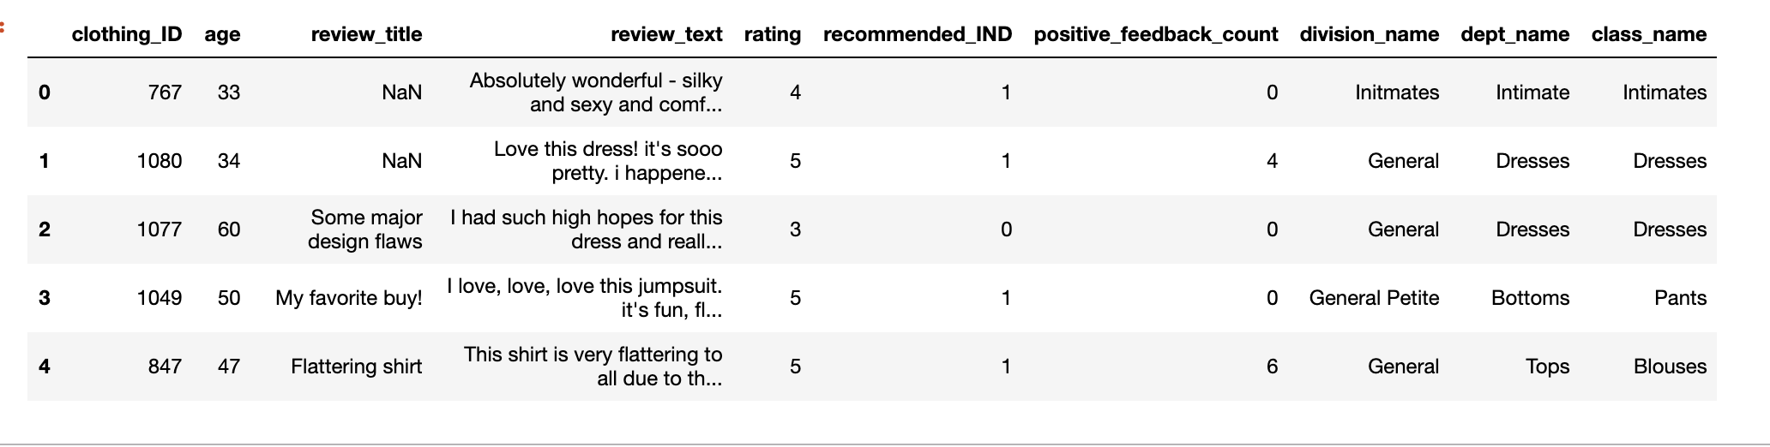
LET’S EXPLORE THE GIVEN DATASET
Notes:
This is a Women’s Clothing E-Commerce dataset revolving around the reviews written by customers. Its nine supportive features offer a great environment to parse out the text through its multiple dimensions. Because this is real commercial data, it has been anonymized, and references to the company in the review text and body have been replaced with “retailer”.

Slide 6
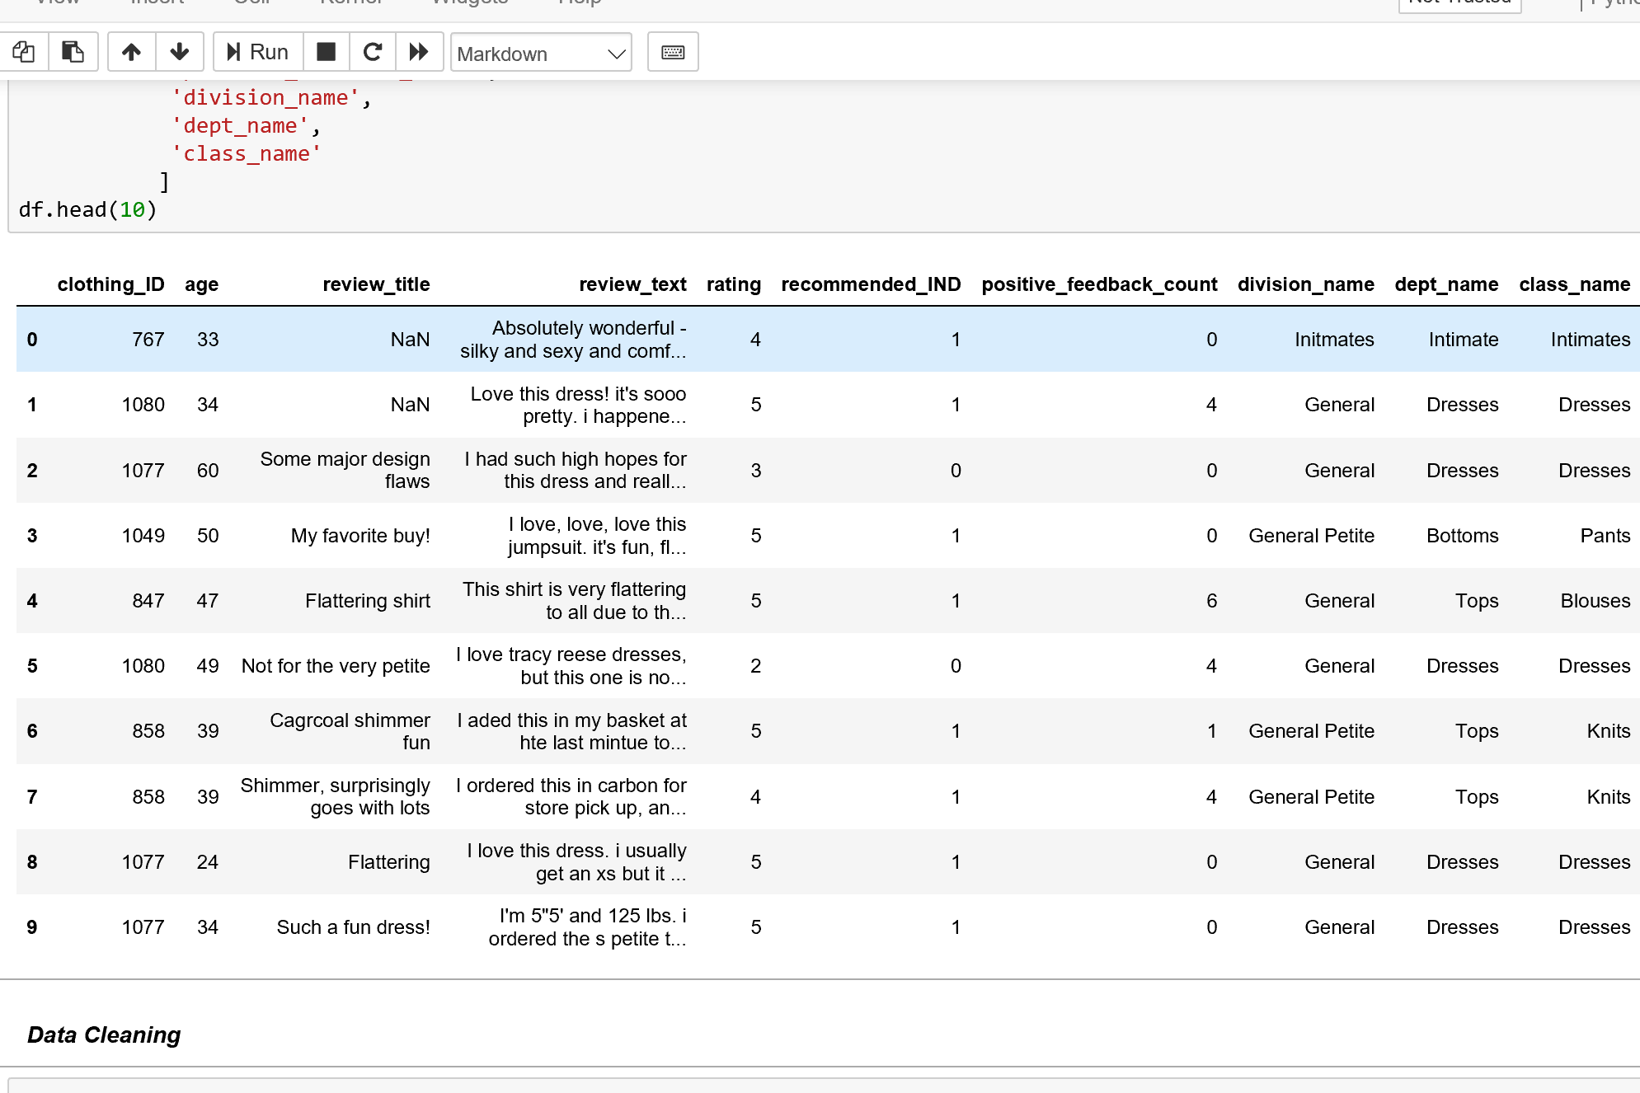
Data Set for the year 2017-2018:

Slide 7
Our columns:
Clothing ID: Integer Categorical variable that refers to the specific piece being reviewed.
Age: Positive Integer variable of the reviewers age.
Title: String variable for the title of the review.
Review Text: String variable for the review body.
Rating: Positive Ordinal Integer variable for the product score granted by the customer from 1 Worst, to 5 Best.
Recommended IND: Binary variable stating where the customer recommends the product where 1 is recommended, 0 is not recommended.
Positive Feedback Count: Positive Integer documenting the number of other customers who found this review positive.
Division Name: Categorical name of the product high level division.
Department Name: Categorical name of the product department name.
Class Name: Categorical name of the product class name.

Slide 8
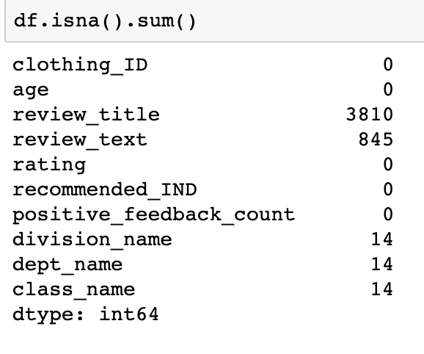
REMOVING COLUMNS
Notes:
We removed a column review_tilte as there are more null values , we handeled the sentiment analysis for review _text by giving the value 99

Slide 9
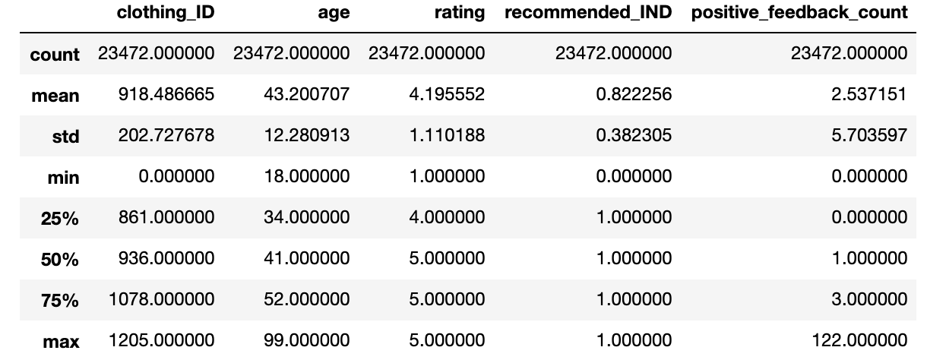
OUR DATA DESCRIPTION

Slide 10
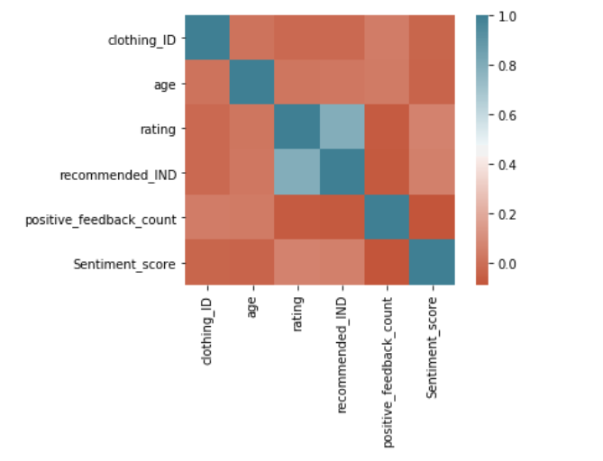
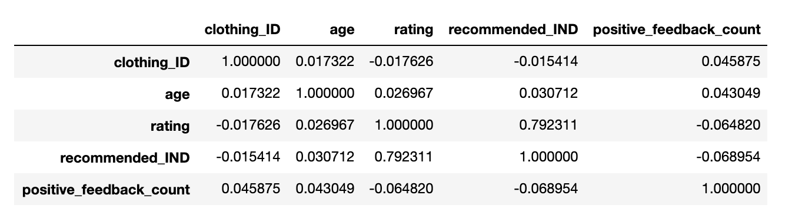
CORRELATION

Slide 11
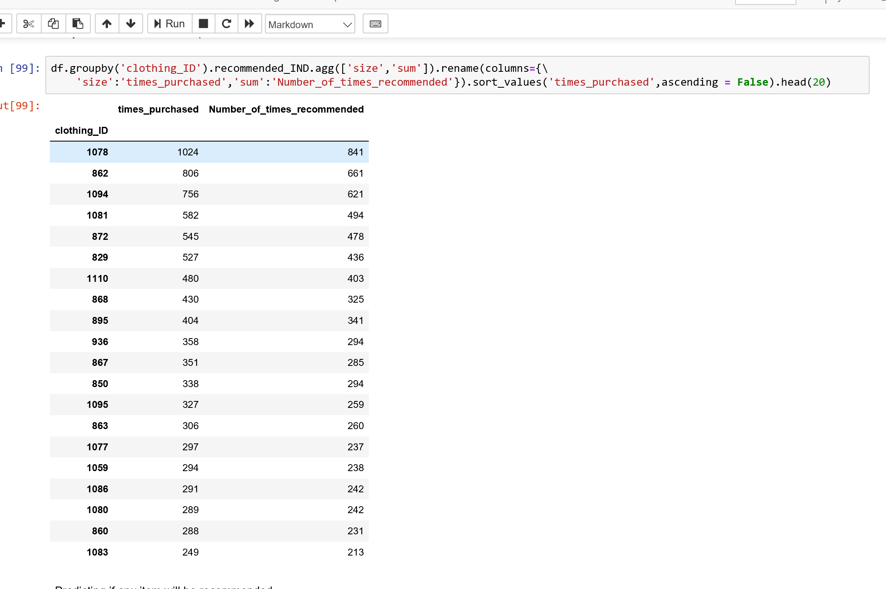
Why are the recommendations important?

Slide 12

Does other customer recommendations matter:
The number of times a product is recommended is directly proportional to the number of times the product has been bought.
Notes:
WHY? It is helpful for the company to validate their customer recommendation.

Slide 13
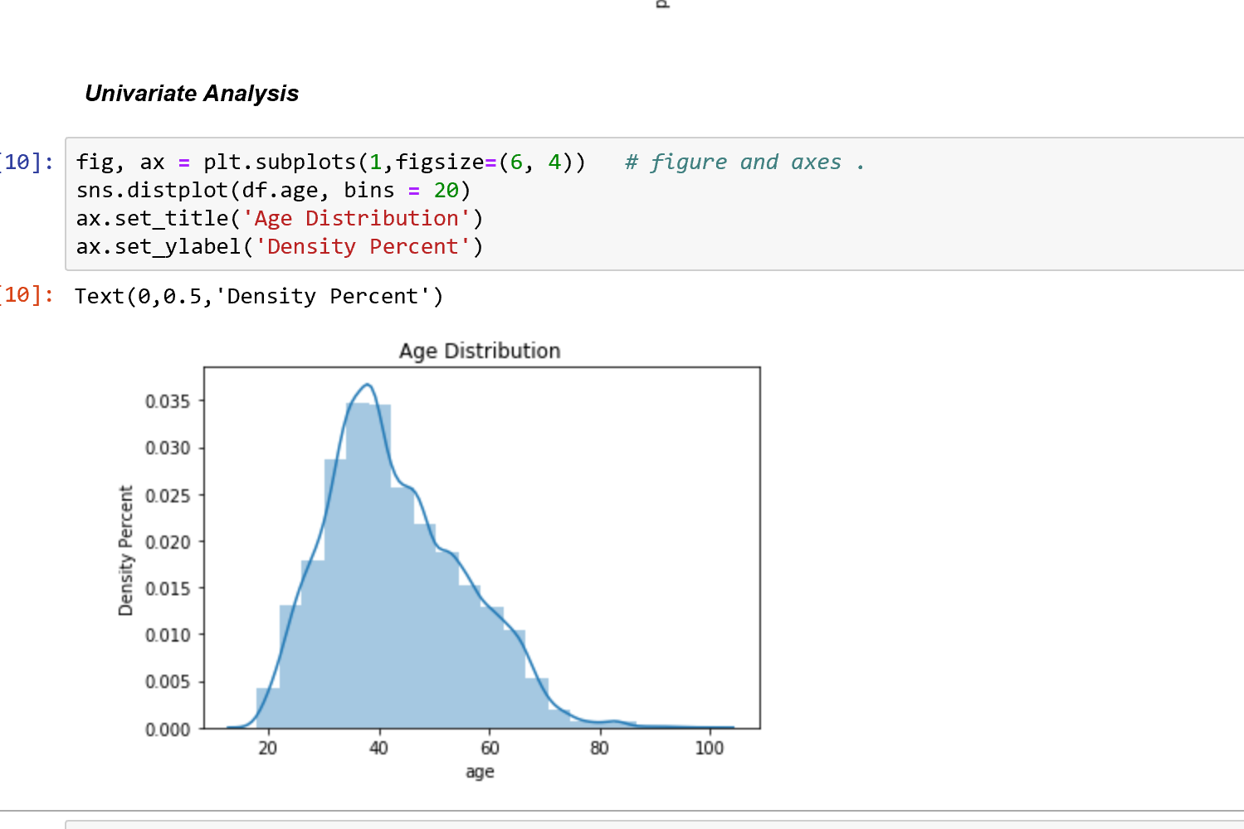
Customer Age Distribution:

Slide 14

Customer Segmentation:
1- 16 : No customer count
17- 35: distributed customer count
35 - 45: maximum customer count

Slide 15

Recommendation:
The company can focus on the 1-16 or 17-35 years age group.
Notes:
They can introduce clothing for the age groups 1-16 and can also increase the apparels which can attarct the 17-35 years of age.

Slide 16
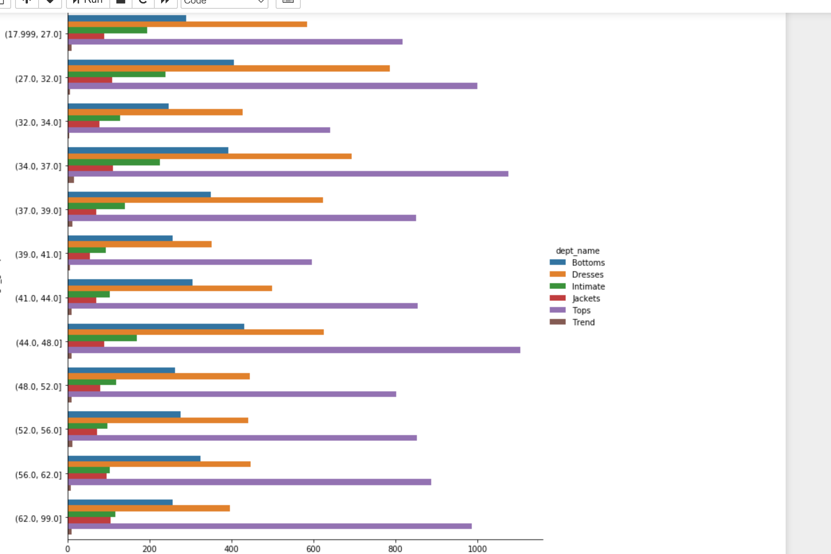
Preference Of Departments across Age Groups
Notes:
Age groups, departments , most, least add ons.

Slide 17

Upselling ?
Upselling is a sales technique where a seller induces the customer to purchase more expensive items, upgrades or other add-ons in an attempt to make a more profitable sale.
Recommendation:
Need to rethink the Trends apparels which is least preferred department.
As they have more customers buying the tops, the company can focus on the bottoms so that they can upsell their bottoms.
Notes:
Suggestive selling on Bottoms

Slide 18
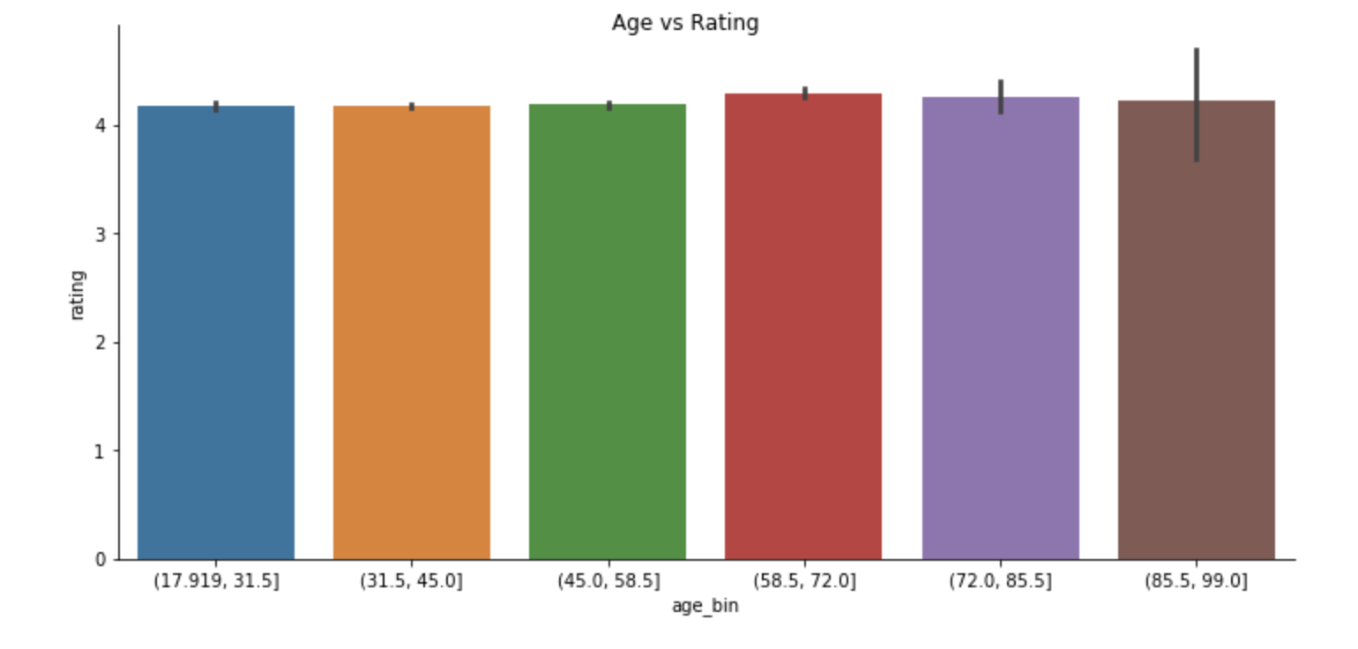
AGE VS RATING
Notes:
We have divided the customer age into groups starting from 17 to 99 . so based on the age range , we plotted the graph aginst the ratings in which we got similar count of ratings for ll the age ranges.

Slide 19
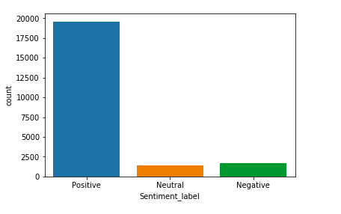
Sentiment Distribution
Notes:
To classify each review whether it recommends the reviewed product or not and whether it consists of positive, negative, or neutral sentiment.
Through sentiment analysis, we got the total positive, negative and neutral score. . In this dataset, the positive sentiment is more for most of the products when compared to the other products which indicates most of the products purchased our liked by the customer. The sentiment polarity is widely used by companies for understanding their clients through their customer support in social media, or through their review boards online.

Slide 20
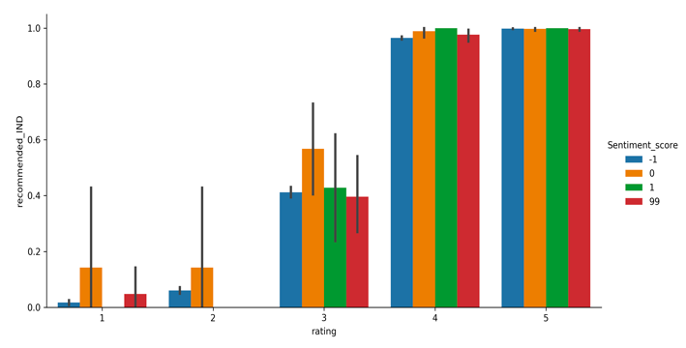
Sentiment Recommendation and Rating Relation
Notes:
One of the interesting finding is about the review text, sentiment recommendation and rating. Customers who rated and recommended the products gave negative review text. The customer might not like the apparel type or size. So the marketing team can focus on the review text given by the customer, in order to retain the customer and to improve their shopping experience.

Slide 21
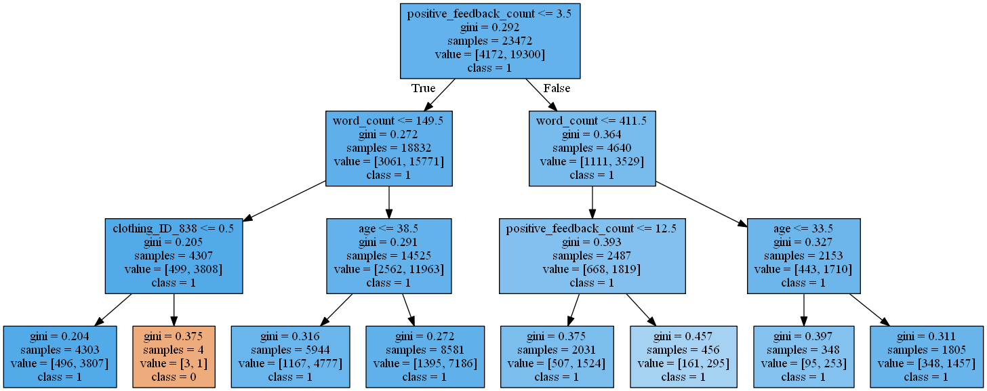
Classifying Recommendations

Slide 22


